Slide 1


PwC Case
WonderFour
Dinterman, Anders
Li, Ruitong
Lin, Shengda
Zhang, Tina

Slide 2
Overview
Driver Analytics
Location Analytics
Compare drivers’ risk based on age, Gender and Marital Status
Identify areas with higher potential risk to determine premium
01
04
02
Vehicle Analytics
Agency & Branch Analytics
03
Compare vehicles’ risk based on car Maker, Model and Model Year
Identify agency and branch with relative poor operation performance

Slide 3
Recommendations
Increase the premium charged to the specific group drivers, such as divorced women in age 45-64.
Increase the premium charged to the specific vehicles, such as, Dodge Challenger 2007, BMW X5 2009.
Driver
Vehicle
Implement more strict rules when processing the applications from specific areas, such as, Contra Costa, Yolo and Sacramento.
Pay more attention to the risk assessement management of Agency 11,16,4
Implement policies to reduce expense.
Agency & Branch
Location

Slide 4
Driver Analytics
By Gender and Marital Status
Gender Analysis
Marital Status Analysis
The loss ratio for male and female is almost the same, and the loss ratio for male is slightly higher.
Divorced people have the highest loss ratio
The insurance company should take gender and marital status into account when deciding premium charged to customers

Slide 5
Driver Analytics
25-34
By Age
Loss Ratio above Average
25 - 34
45 - 54
55 - 64
23%
22%
26%
The insurance company should increase premium charged to customers whose ages fall into the range with high loss ratio

Slide 6
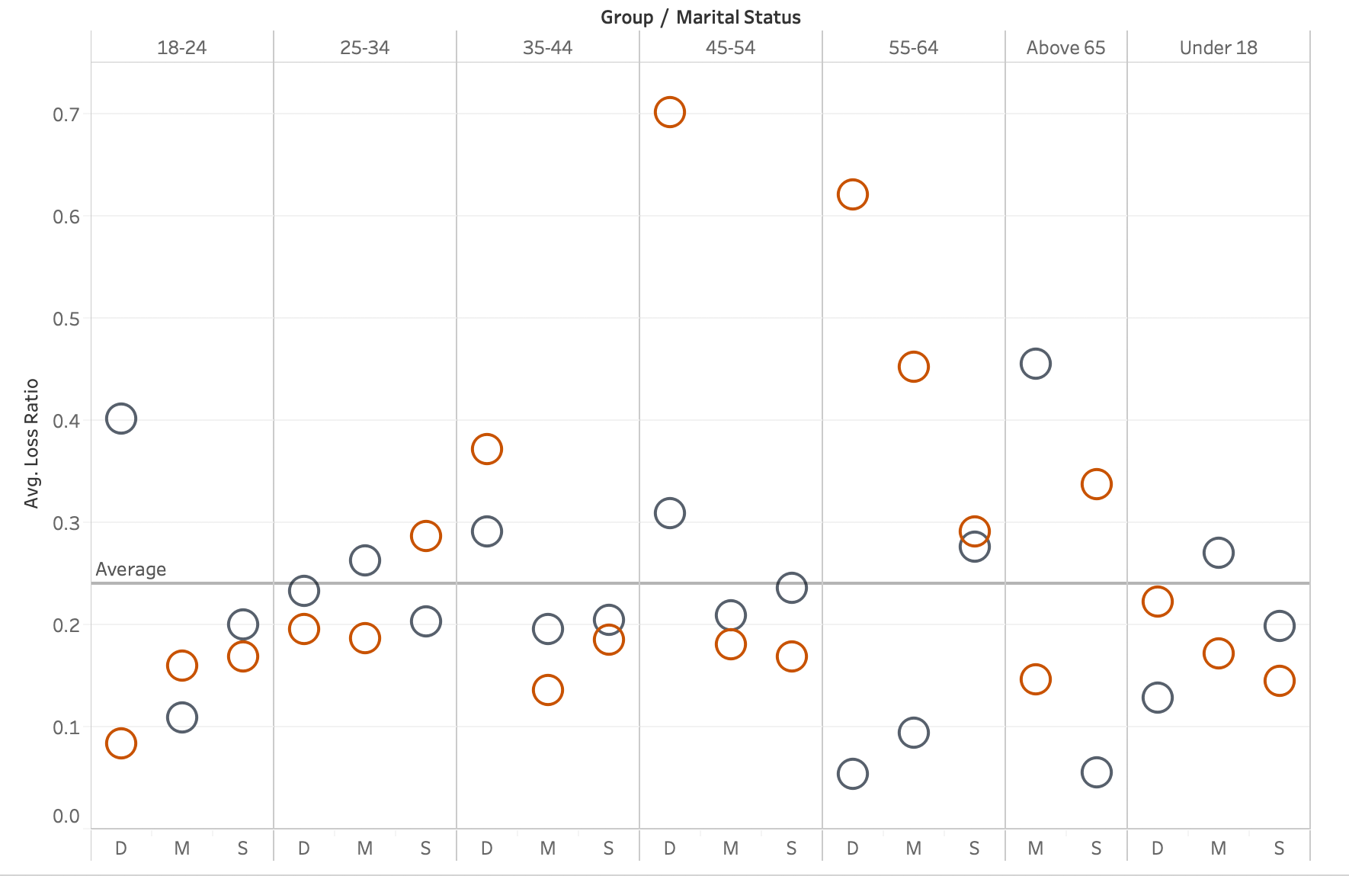
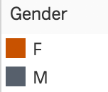

Driver Analytics
By Age, Gender and Martial Status
The 45 to 64 year-old divorced woman show a significantly higher loss ratio compared with other drivers
The insurance company should increase the premium it charged to specific group of drivers who have a loss ratio above 40% to balance the risk of the customers

Slide 7
Vehicle Analytics
By Car Maker
Vehicles produced by certain car makers have significant higher loss ratio compared with other cars.
The Top Five car makers with the highest loss rate are Lexus, BMW, Hyundai, Mercedes-Benz and Jaguar.
The insurance company should increase the premium it charged to owners of certain brand cars to balance the risk of the customers

Slide 8
Vehicle Analytics
By Car Maker, Model and Model Year
We highly recommend the insurance company to increase the premium for the specific vehicles which the loss ratio is greater than one

Slide 9
Vehicle Analytics
By Car Maker, Model and Model Year
We also recommend the insurance company to increase the premium for the specific vehicles which the loss ratio is greater than 0.7

Slide 10
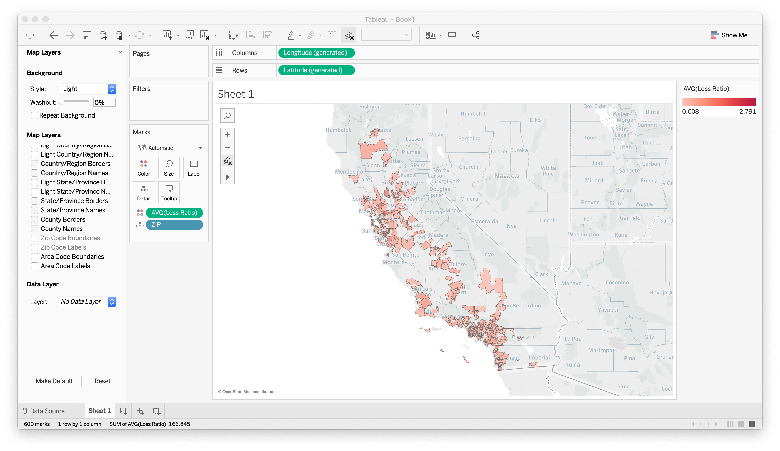
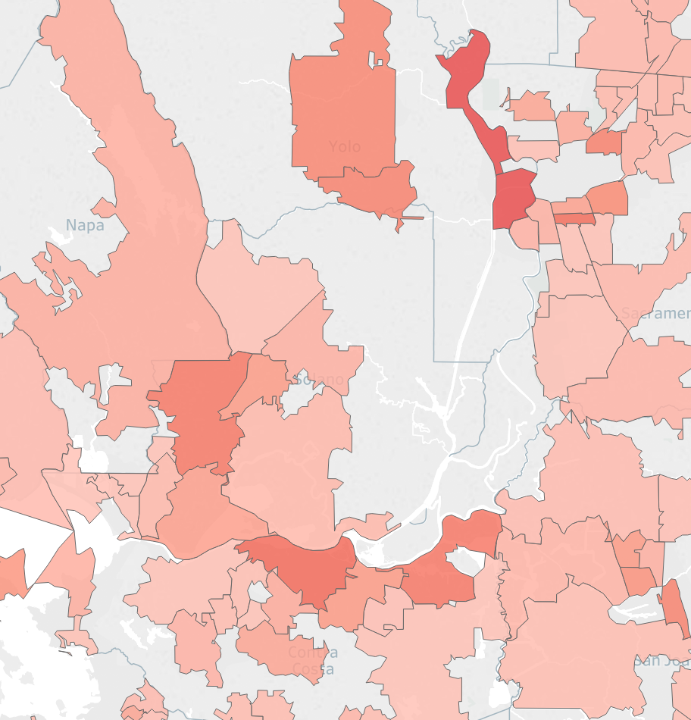
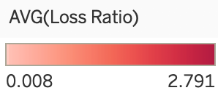
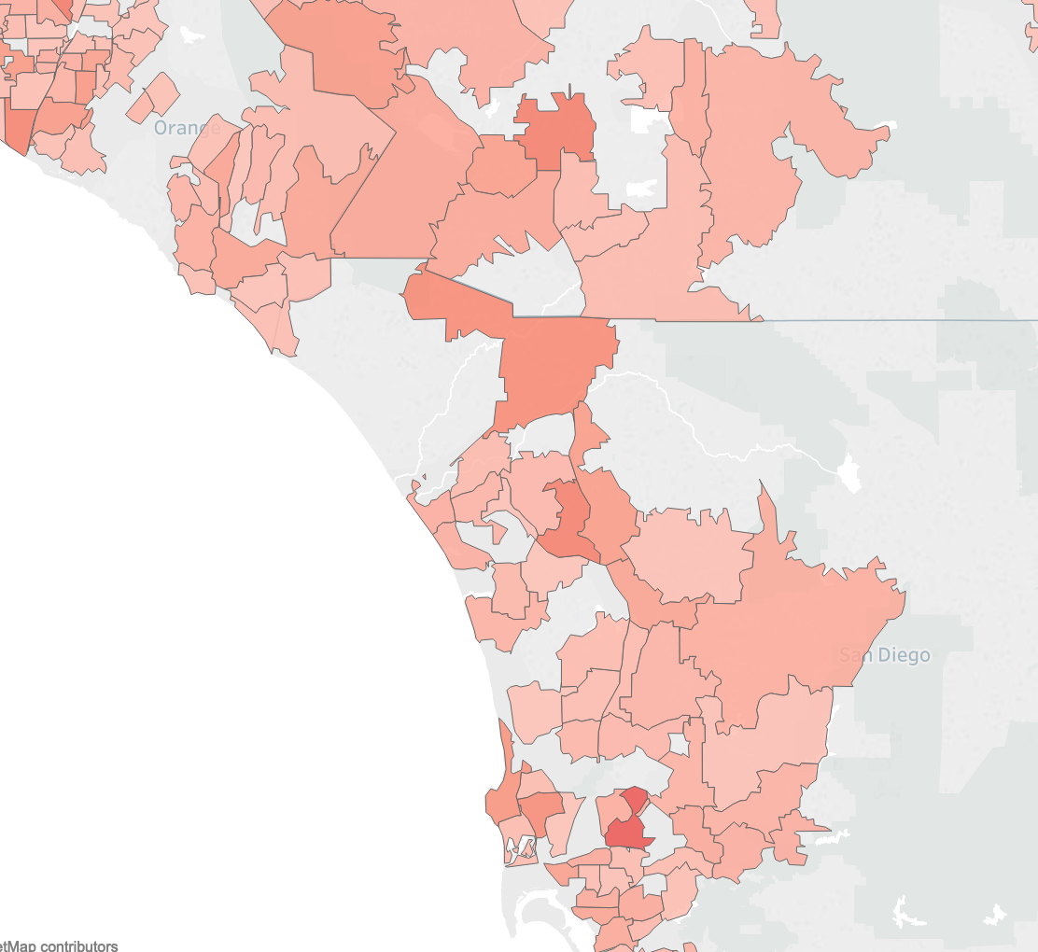
Location Analytics
Loss ratio around Contra Costa, Yolo and Sacramento is higher than one, which means losses exist in these areas.
The insurance company should implement more strict rules when processing the applications from those areas or increase the premium to cover the potential losses

Slide 11
Agency Analytics
Total Premium of Each Agency
Loss Ratio of Each Agency
The top three agencies with the highest total premium are 3, 15, 7. The last three agencies with the lowest total premium are 16, 14, 12.
The top three agencies with the highest loss ratio are 11, 16, 4.
Insurance companies need to pay more attention to agencies 11, 16 and 4 to ensure that they do not reduce risk assessment criteria when selling policies.

Slide 12
Branch Analytics
Number of Claim
Expense ratio
Since Norwak CA Branch has the highest expense ratio, the insurance company should pay more attention to this branch and try to decline the expense to increase profitability

Slide 13
Q & A

Slide 14
Thanks For Watching !
Have A Wonderful Day!

